Slide 1
Credit Card Approval Analysis

Slide 2
Group 338
Team Members
First Name | Last Name | Email address
Amruta | Lele | alele@hawk.iit.edu
Hashmitha | Shantharam | hshantharam@hawk.iit.edu
Shantanu | Sagwal | ssagwal@hawk.iit.edu

Slide 3
Description
Banks receive a lot of applications for credit card everyday. Many of the applications are rejected based on the applicant’s loan balance, income level and other factors.
Manually analysing the applicant’s background could be a tedious job. Thus these tasks can be automated using Machine Learning techniques and most of the banks are implementing these techniques to minimise their work load, to reduce errors and to save time.
Credit scores are widely used in the financial industry to decide whether to issue a credit card to the applicant. It uses personal information and data submitted by credit card applicants to predict the probability of future defaults and credit card borrowings.

Slide 4
Goal
To use machine learning models such as Decision Tree, KNN etc., to decide if an applicant is eligible to get the credit card approved based on their annual income, occupation type, property details, monthly overdue and other similar factors.
To perform Vintage Analysis to classify the customer data into 'good' or 'bad’ customer based on their credit status.

Slide 5

Approach
Import dataset
Use Different Pre-processing techniques to normalize the data that can be used for Analysis.
Data visualization for better understanding of data
Develop and Compare different classification models to see which one performs the best on the data.
Identify if an applicant is 'good' or 'bad' client in the imported data set based on Customer’s credit status.

Slide 6
Dataset
Data Set : “Credit Card Approval Dataset” from Kaggle.
https://www.kaggle.com/rikdifos/credit-card-approval-prediction
The data has two files as follows:
Application Record: It contains 438,557 applicant records with 18 columns which includes features such as total income, education type, occupation type, days employed etc.
Credit Record: It contains month balance and Status mapped with each individual credit card user ID with approximately 1,048,576 rows.

Slide 7
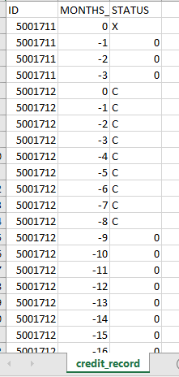
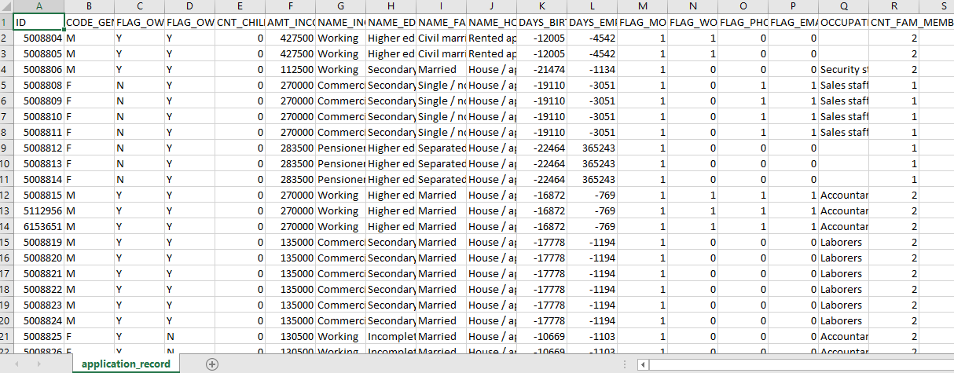
Dataset
Credit Record : Application Record:

Slide 8
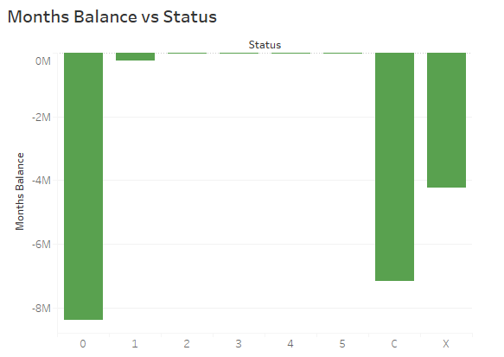
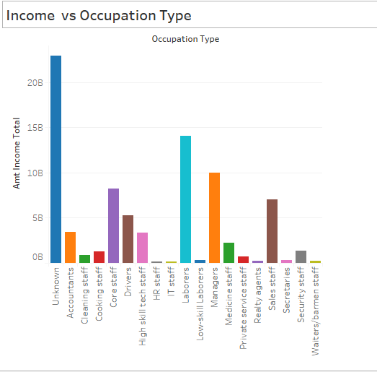
Visualization of Dataset
Using Tableau for visual representation of data.
Visualization of the Total Amount of Income for each Occupation Type from Application Records.
Visualization of the status calculated corresponding to the monthly balance from Credit Records.

Slide 9
Pre-Processing
Data pre-processing allows users to remove unwanted data and to fill out missing values so that user will have more valuable information to perform mining operations.
The below pre-processing steps are performed on our data:
Check for duplicates and remove the duplicate fields
Check for missing values and Fill missing values with relevant data
Drop columns that might not contribute much for analysis.

Slide 10
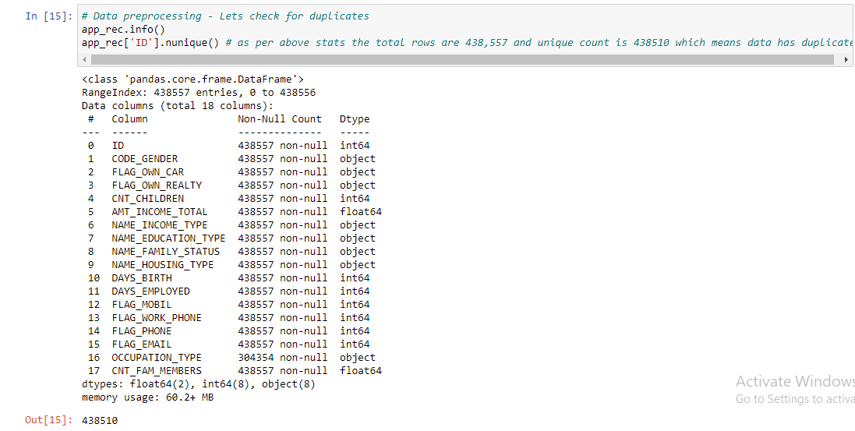
Data Pre-Processing
1.1 Check for duplicate entries in Application Record.

Slide 11
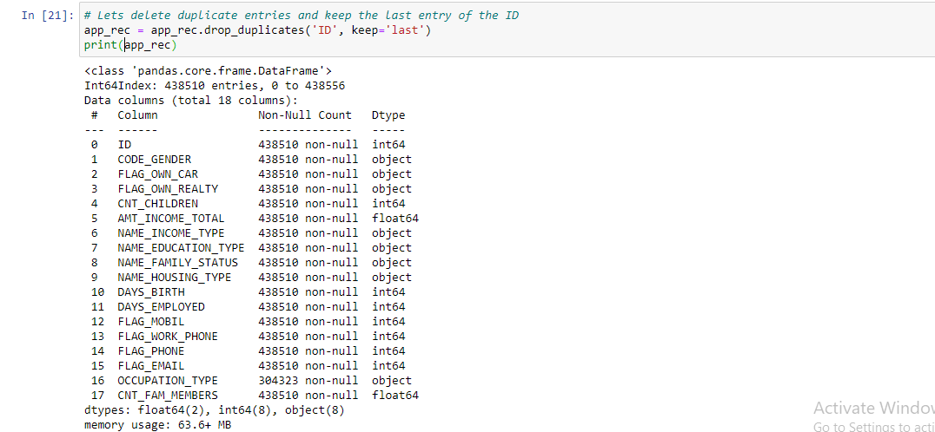
Data Pre-Processing
1.2 Remove duplicate records from Application Records.

Slide 12
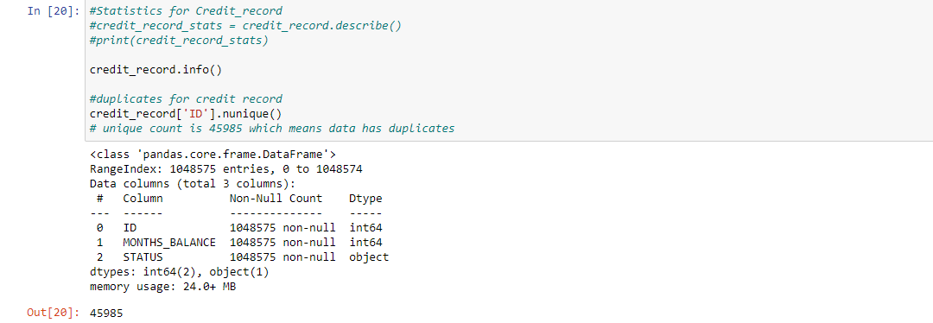
Data Pre-Processing
1.3 Check for duplicate entries in Credit Record

Slide 13
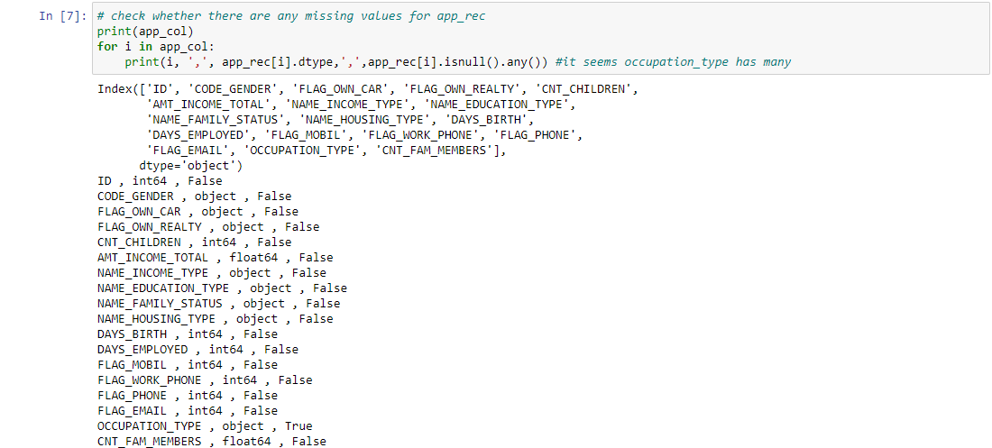
Data Pre-Processing
2.1 Check for missing values in Application Record

Slide 14
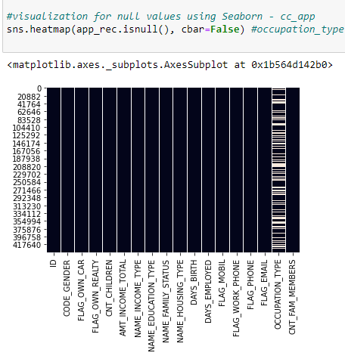
Visualization of Missing Values
Visualizing the missing values in application record using Seaborn library.

Slide 15
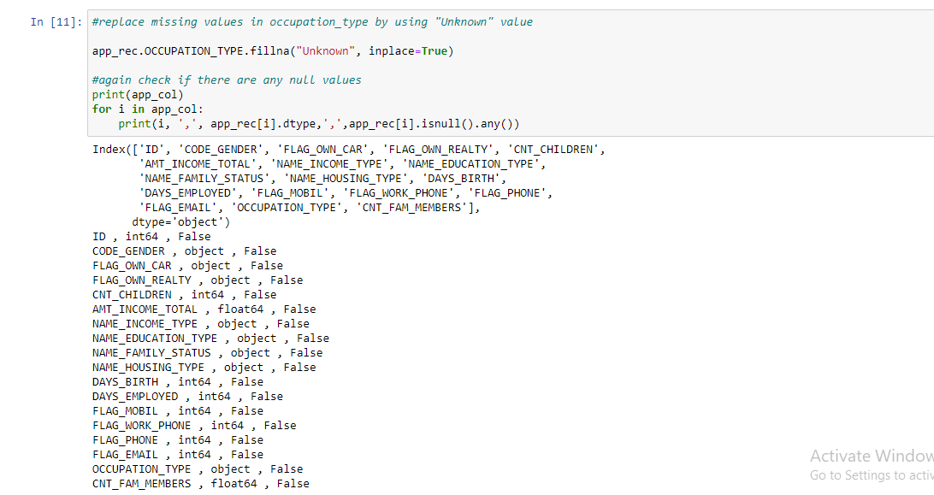
Data Pre-Processing
2.2 Replacing the missing value column(Occupation_type) with “Unknown”.

Slide 16
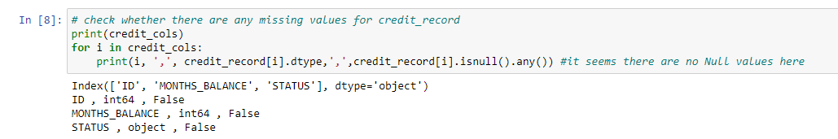
Data Pre-Processing
2.3 Check for missing values in Credit Record

Slide 17
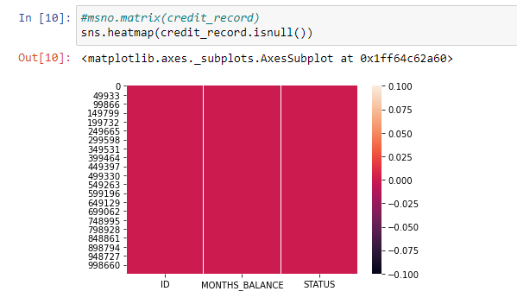
Visualization of Missing Values Visualizing the missing values in Credit Record using Seaborn library.

Slide 18
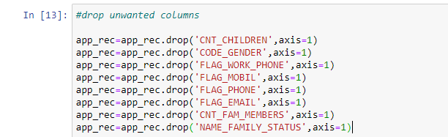
Data Pre-Processing
3. Drop columns that might not contribute much for analysis.

Slide 19
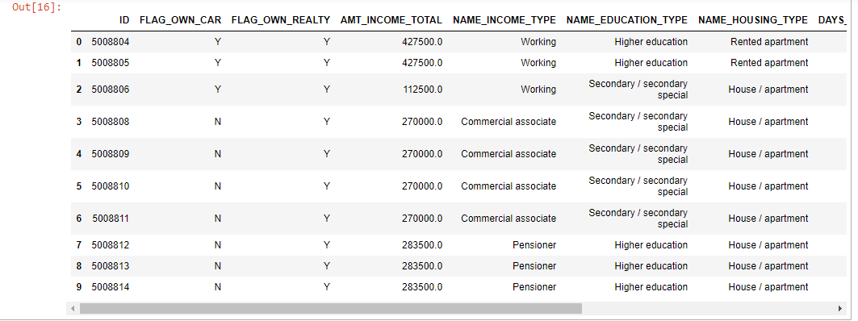
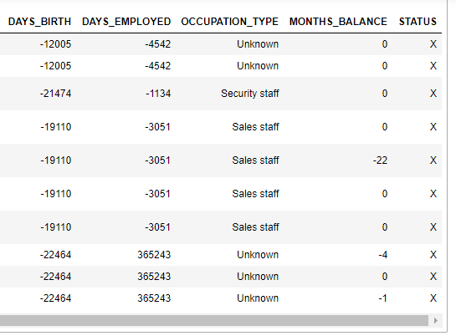
Pre-Processed Data
The data has been checked for duplicates and all the duplicate values are removed.
The Occupation Type column had missing values and it has been filled with “Unknown” value.
The unwanted columns such as gender, family status, family members etc., has been dropped.
Both the application record and credit record are merged for further analysis.

Slide 20

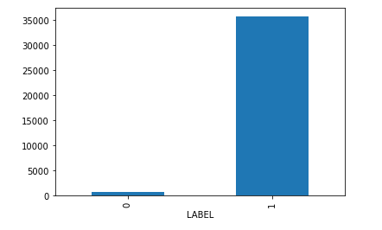
Analysis of good/bad customer
Building a machine learning model to predict if an applicant is 'good' or 'bad’ using vintage analysis.
The vintage analysis measures the performance of a portfolio in different periods of time after the credit card was granted.

Slide 21
Classification
Classification :
We have split 80% of data as training set and 20% as testing set.
By analysing the training set, the target class is predicted to set the boundaries for the below classification models to identify the best model that suits our dataset.
Techniques used:
Logistic Regression
Estimates discrete values with the assumption of independent variables
KNN
Data must be numeric and normalized.
Parameters: distance measure and value of K
Naïve Bayes
Based on the assumption of conditionally independence, estimate the predictor value.
Decision Tree and Random Forest
Convert numerical to categorical data and use encoding label.

Slide 22
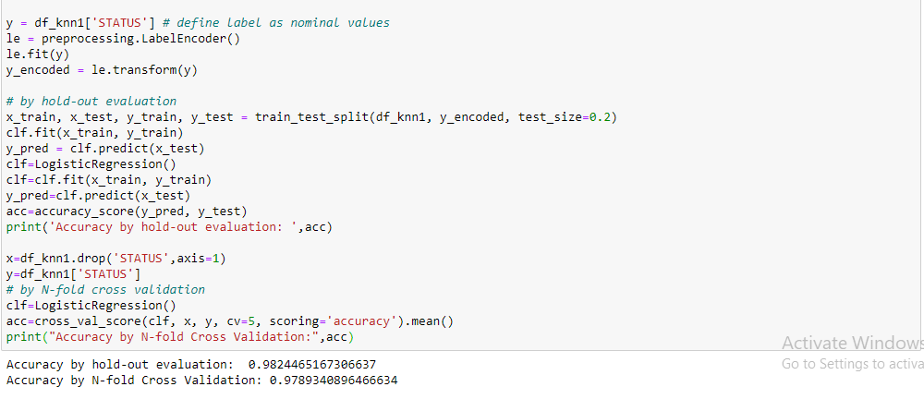
Classification – Logistic Regression
Result:

Slide 23
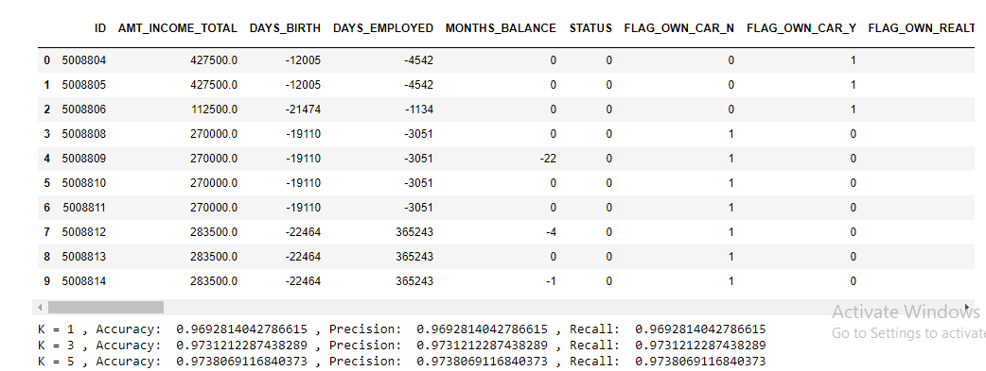
Classification - KNN
Result:

Slide 24
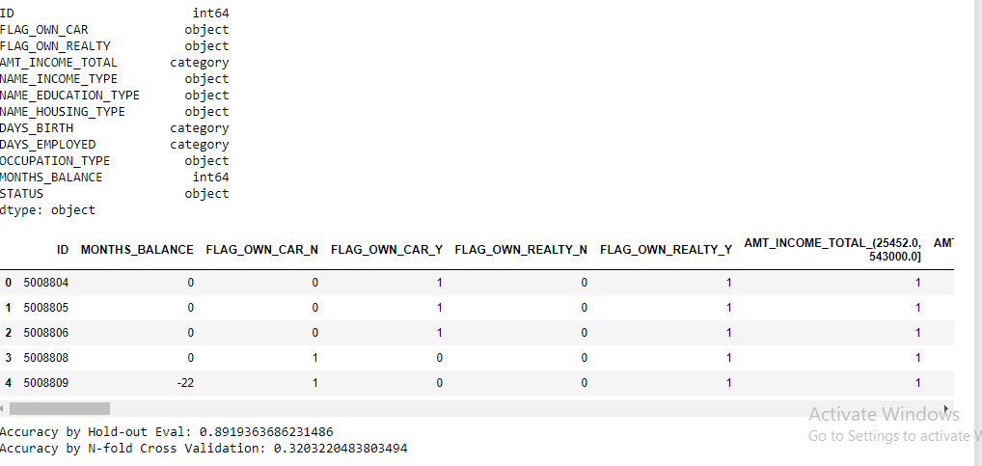
Classification-Naive Bayes Classifier
Result:

Slide 25
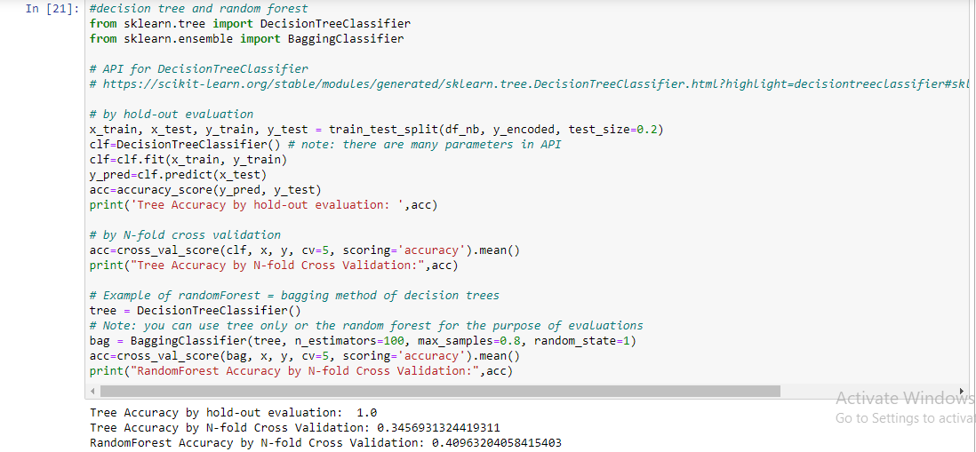
Classification-Decision Tree and Random Forest
Result:

Slide 26
Comparison of Classification Models
From the table it is evident that the Decision Tree provides highest accuracy, and it suits best for our dataset.
Model | Accuracy
Logistic Regression | 0.98
KNN classifier | 0.97
Naïve Bayes | 0.89
Decision Tree | 1.0
Random forest | 0.40

Slide 27
Thank You!

